Slide 1
WorkshopPLUS - Windows PowerShell: Foundation Skills
Notes:
Version: 02/08/2019 13:08:16

Slide 2
Disclaimer

Slide 3
PowerShell Built-In Help System

Slide 4
Using the PowerShell Help System

Slide 5
After completing Using the PowerShell Help System, you will be able to:
Understand how the help system works
Update help files

Slide 6
Get help using Get-Help

Slide 7
PowerShell get-help
PowerShell has a building help system via command “Get-Help”
PowerShell help per concept: (About_)
https://docs.microsoft.com/en-us/powershell/module/microsoft.powershell.core/about/

Slide 8
Help for Cmdlets – Default Short View
PS C:\> Get-Help Get-ChildItem #or PS C:\> Get-ChildItem -? NAME Get-ChildItem SYNOPSIS Gets the files and folders in a file system drive. SYNTAX Get-ChildItem [[-Path] <String[]>] [[-Filter] <String>]... ... DESCRIPTION The Get-ChildItem cmdlet gets the items in one or more... ... RELATED LINKS Online version: http://technet.microsoft.com/library/h... ... REMARKS To see the examples, type: "get-help Get-ChildItem ... ...
Notes:
Note that the following command does not work:
Get-ChildItem /?

Slide 9
Help for Cmdlets – Parameters
Parameter | What you Get | Example
<None Specified> | Command Name, Synopsis, Syntax, Description, Related Links, Remarks | PS C:\> Get-Help Get-ChildItem
-Examples | Name, Synopsis, Examples | PS C:\> Get-Help Get-ChildItem –Examples
-Detailed | Name, Synopsis, Parameters, Examples | PS C:\> Get-Help Get-ChildItem –Detailed
-Full | Name, Synopsis, Syntax, Description, Parameters, Inputs, Outputs, Notes, Remarks, Examples, Related Links | PS C:\> Get-Help Get-ChildItem –Full
Notes:
Note that the following command does not work:
Get-ChildItem /?

Slide 10
Help for Cmdlets – Parameters
Parameter | What you Get | Example
-Parameter <Names> | Parameters Specified Only | PS C:\> Get-Help Get-ChildItem –Parameter Filter
-Path <Path> | Cmdlet help relative to a Path | PS C:\> Get-Help Get-ChildItem –Path C:\
-Online | Displays online help in Internet Browser. | PS C:\> Get-Help Get-ChildItem –Online
-ShowWindow | Shows help in an external Window in –Full mode. | PS C:\> Get-Help Get-ChildItem –ShowWindow
Notes:
Note that the following command does not work:
Get-ChildItem /?

Slide 11
Help for Specified Cmdlet Parameter(s)
PS C:\> Get-Help Get-Counter -Parameter Counter -Counter <String[]> Gets data from the specified performance counters. Enter one or more ... Each counter path has the following format: "[\\<ComputerName>]\<CounterSet>(<Instance>)\<CounterName>" ... Required? false Position? 1 Default value Accept pipeline input? true (ByValue, ByPropertyName) Accept wildcard characters? True

Slide 12
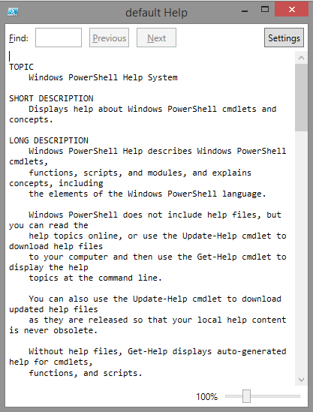
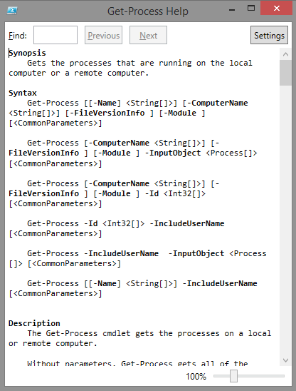
Get-Help -ShowWindow
Display Help in floating window
PowerShell Help Window
PS C:\> Get-Help -ShowWindow
Cmdlet-specific Help Window
PS C:\> Get-Help Get-Process -ShowWindow
Notes:
Get-Help has been enhanced in PowerShell 3.0 in several ways. Let’s start with an easy one. You can use the –ShowWindow option. As always, the cmdlet will get the needed Help Objects, but they will be displayed in a graphical window instead. Try : get-help gps -ShowWindow Some limitations : 1. As always, you can’t Get-Help on several topics at the same time. 2. Get-Help * will be valid, but the –ShowWindow option will be ignored in that case. 3. Possible bug : Get-Help Registry (or other provider) with this –ShowWindow option. More information, see get-help get-help –Full

Slide 13

Demonstration
Help About General Topics

Slide 15
Getting help for PowerShell concepts

Slide 16
PowerShell Concept Help
PowerShell Concept help is available in Shell and ISE
Concept help is also documented on MS docs
All topics start with About_

Slide 17
Concept Help in the Console
Conceptual help topic names start with “about_”
PS C:\> Get-Help about_
Name Category Module Synopsis
---- -------- ------ --------about_Aliases HelpFile Describes how to...
about_Arithmetic_Operators HelpFile Describes the op...
about_Arrays HelpFile Describes arrays...
about_Assignment_Operators HelpFile Describes how tp...
about_Automatic_Variables HelpFile Describes variab...
...
Notes:
Conceptual help topics in PowerShell begin with "about_", such as "about_Comparison_Operators".
To see all "about_" topics, type Get-Help about_*.
To see a particular topic, type Get-Help about_<topic-name>, such as Get-Help about_Comparison_Operators.

Slide 18
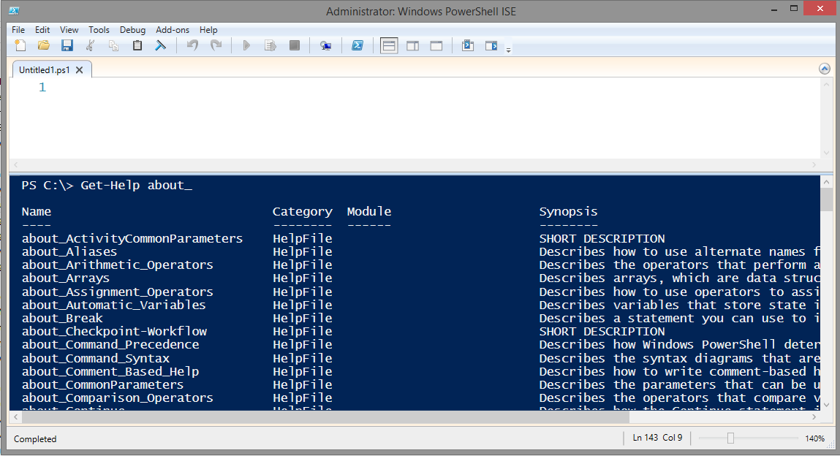
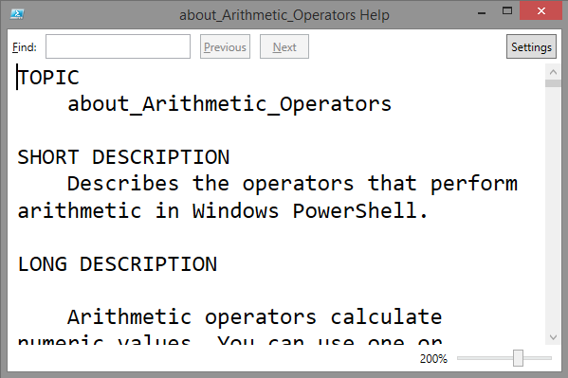
Concept Help in the ISE
Type Get-Help about_ in the console pane
Click on an item in the result set
Press F1
1
2
3

Slide 19
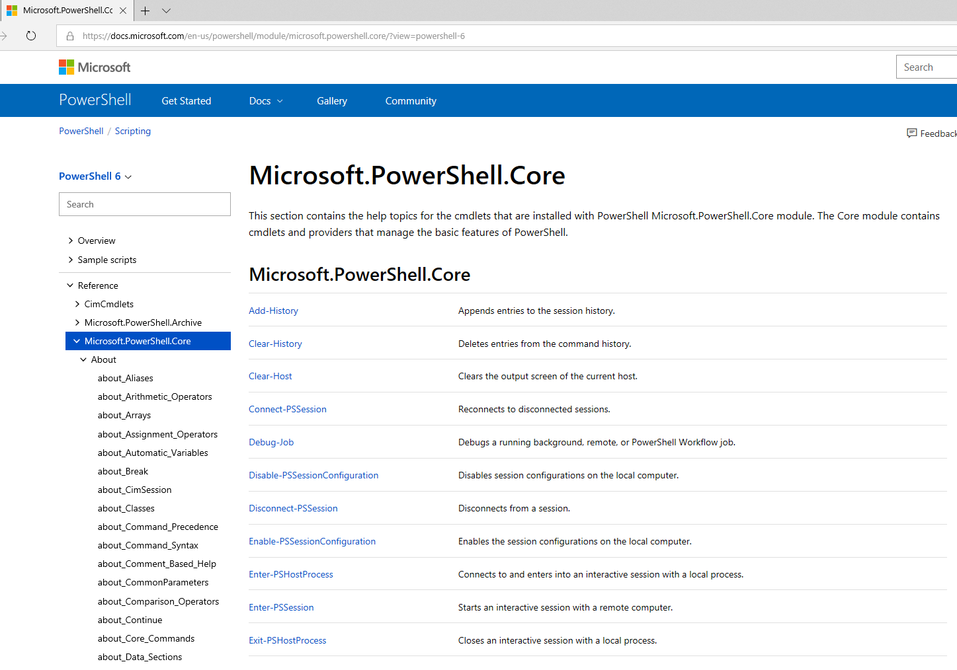
About Help on Microsoft Docs
https://docs.microsoft.com/en-us/powershell/

Slide 20
Demonstration
Get-Help

Slide 22
Updatable Help

Slide 23
Updatable Help
Help contents not shipped with v3.0+
Help topics must be downloaded before they can be used locally
Update-Help (pulls from direct Internet access or offline copies)
Save-Help (allows help to be re-distributed)
Help is updated per Module:
Help readily updated by authors
No need to ship updates with Service Packs or new module download
Module authors designate URL for help download in module manifest
Module author provides web site URL targets
Notes:
When running console in v2 mode, Help only available if downloaded already in v4 mode

Slide 24




Update-Help Diagram (Internet Connected)
Update-Help
Internet
Update-Help
Update-Help

Slide 25
Updatable Help – With Internet Access
Automatically downloads Help content for Cmdlets and modules in current session (including discoverable modules)
Only downloads updated help topics
For system modules, administrative elevation required
Run PS window as admin, then run update-help
Only updates Help once per day even if run multiple times
-Force can be used to update each time
HelpinfoURI property of modules indicates URL for download
Notes:
For more info:
Get-help About_Updatable_Help
Get-help Update-Help -Full
PowerShell 4.0 uses the same Help system as previous versions. Help is defined as “Help Objects”, which are physically stored on files. But in PowerShell 4.0 these Help files are not static. In fact, they’re not even installed with PowerShell. They can -and should- be updated. You download Help from the Internet. This allows installing and updating the Help files only when needed. This is especially useful in Modules, which could get updates more frequently than the basic cmdlets. To download the Help files, you only need to use Update-Help without a –SourcePath parameter. It will download Help files from the Microsoft Download Server on the Internet and save them in the right places. Running as an administrator (elevated) is mandatory because some Help files are common to all users. You can also use the –Force option. Without it, the download is restricted to once a day. This avoids unnecessary traffic if you set this command in the Profile, for example. For learning and troubleshooting purposes, -Verbose is also useful. Remember that the old Get-Help –Online option is still available.

Slide 26
Updatable Help – No Internet Access
Save-Help cmdlet saves help files locally for later use:
On computer with Internet Access:
On computers without Internet Access (no GPO source path):
On computers without Internet Access (with GPO source path):
PS C:\> Save-Help –DestinationPath \\SomeServer\SomeShare
PS C:\> Update-Help –SourcePath \\SomeServer\SomeShare
PS C:\> Update-Help
GPO Setting:
Computer > Policies > Administrative Templates > Windows Components > Windows PowerShell
Enable "Set the default source path for Update-Help."
Notes:
For more information:
Get-help About_Updatable_Help
Get-help Save-Help -Full
If your computers do not have Internet connectivity, you can still use the Updatable Help System. You only need one PC connected to the Internet. In this case, you must use the Save-Help cmdlet on the PC and specify a destination folder. The Help files will be downloaded there. You can use the –Force and –Verbose options as before. Remember to run this with elevated privileges. Now all the other computers can get the Help files from this folder (using a share or any other mechanism), by using Update-Help –SourcePath \\Server\SharedFolder

Slide 27

Update-Help Diagram
Update-Help
Save-Help –DestinationPath \\Share
Internal
Folder
Location
Internet
Internal machines do not need Internet access
Update-Help -SourcePath
Optional Default source path location GPO Setting
Notes:
GPO Setting:
Computer > Policies > Administrative Templates > Windows Components > Windows PowerShell
Enable "Set the default source path for Update-Help."

Slide 28
Updatable Help – Modules
Update-Help can be targeted at individual modules
Update-Help –Module ModuleName
Update-Help –Module *
Get-Module ActiveDirectory | Update-Help
Notes:
The –Module option enables you to update the Help files for a single module. If not given, all loaded modules in the session are updated. Using –Module * updates all modules, even the ones not loaded in the session.

Slide 30
Comment-based help topics for functions and scripts

Slide 31
Comment Based Help
Used by the help system to create output of get-help
Other people should be able to understand what your code does
Every script / function you share should have help

Slide 32
Function/Script Comment-Based Help
Special help comment keywords can be used to write Get-Help topics for functions and scripts
Syntax
# .< help keyword> # <help content> -or - <# .< help keyword> < help content> #>

Slide 33
Keywords
.SYNOPSIS
.DESCRIPTION
.PARAMETER <parameter name>
.EXAMPLE
.INPUTS
.OUTPUTS
.NOTES
.LINK
.COMPONENT
.ROLE
.FUNCTIONALITY

Slide 34
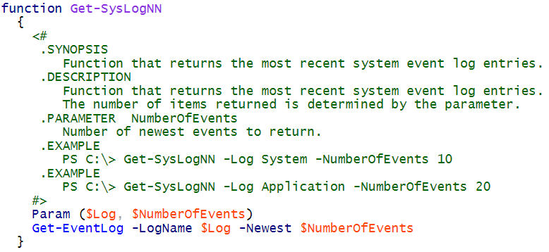
Function Help - Code

Slide 35
Function Help – Shell Output
PS C:\> Get-Help Get-SysLogNN -Full
NAME
Get-SysLogNN
SYNOPSIS
Function that returns the most recent system event log entries.
SYNTAX
Get-SysLogNN [[-Log] <Object>] [[-NumberOfEvents] <Object>]
[<CommonParameters>]
...

Slide 36
Script Help - Code

Slide 37
Script Help – Shell Output
PS C:\> Get-Help .\ScriptHelpExample.ps1 –Full
NAME
C:\scripts\ScriptHelpExample.ps1
SYNOPSIS
Script returns the most recent system event log entries.
SYNTAX
C:\scripts\ScriptHelpExample.ps1 [[-Log] <Object>] [[-NumberOfEvents] <Object>] [<CommonParameters>]
...

Slide 38
Demonstration
Comment Based Help in Scripts and Functions

Slide 40
Using the PowerShell Help System
Notes:
Link to lab:

Slide 41
Microsoft

